Slide 1
DoraeMon explorer hub
Presented By - Disha Sachdeva

Slide 2
Project overview
Doraemon explorer hub :Building an Angular Project for exploring characters and gadgets involved in Doraemon cartoon . Seamlessly navigating through characters , gadgets and gallery via an intuitive navbar . Exploring all the characters and gadgets with a click . Diving deeper into selected character or gadget for its details. Experiencing enhanced functionality with a built-in back feature . Also empowering user with the ability to edit character and gadgets also its details . It also allow user to add new character or gadget or deleting existing one from the list . Additionally providing search functionality. Also used Http Client and In Memory Web Api to provide a smooth experience.

Slide 3
Features
SEARCH FUNCTIONALITY
UPDATE FUNCTIONALITY
ADD FUNCTIONALITY
DELETE FUNCTIONALITY
MESSAGE FUNCTIONALITY

Slide 4
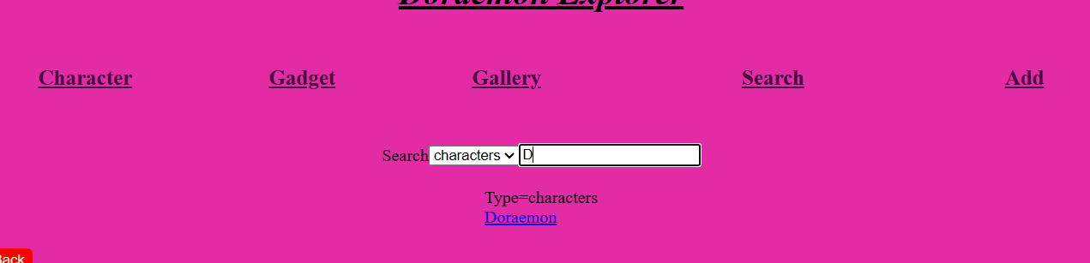
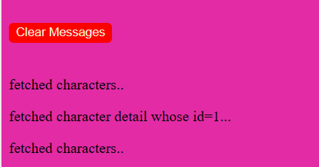
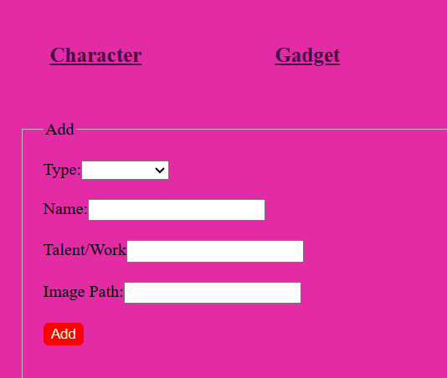
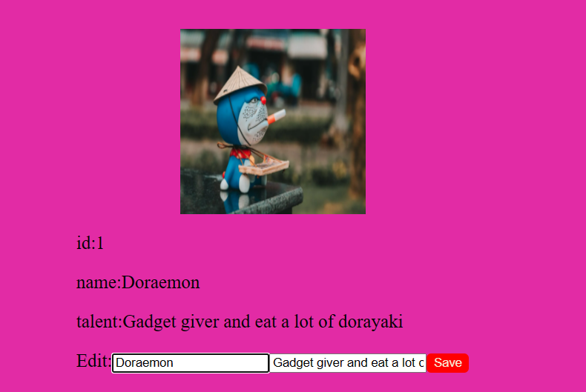
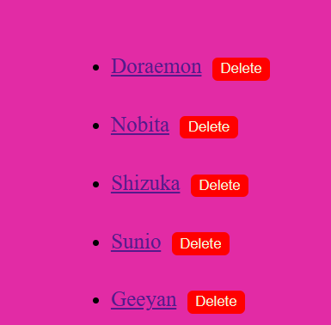
SEARCH
MESSAGE
ADD
EDIT
DELETE

Slide 5
APP COMPONENT
NAV BAR
CHARACTERS GADGETS GALLERY ADD SEARCH
CHARACTER COMPONENT
GADGET COMPONENT
ADD COMPONENT
SEARCH COMPONENT
CHARACTER DETAIL COMPONENT
GADGET DETAIL COMPONENT
GALLERY COMPONENT
DATA SERVER
(In Memory Db Service)
DATA SERVICE
MESSAGE SERVICE
MESSAGE COMPONENT

Slide 6
LEARNING OUTCOME
ROUTING
BINDINGS
DIRECTIVES
DEPENDENCY INJECTION
CREATING A DATA SERVER
ERROR HANDLING
CRUD OPERATIONS
SEARCHING

Slide 7
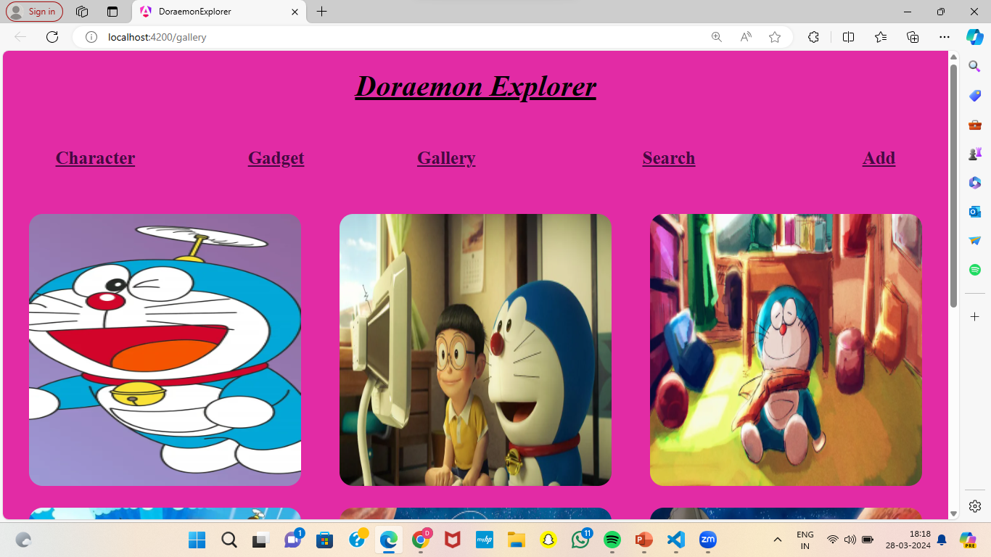
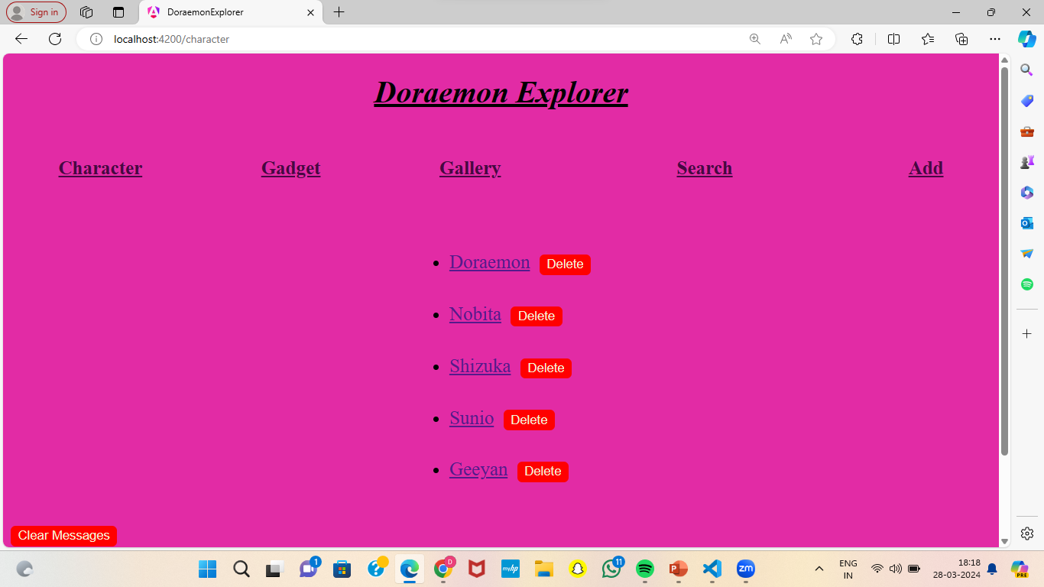
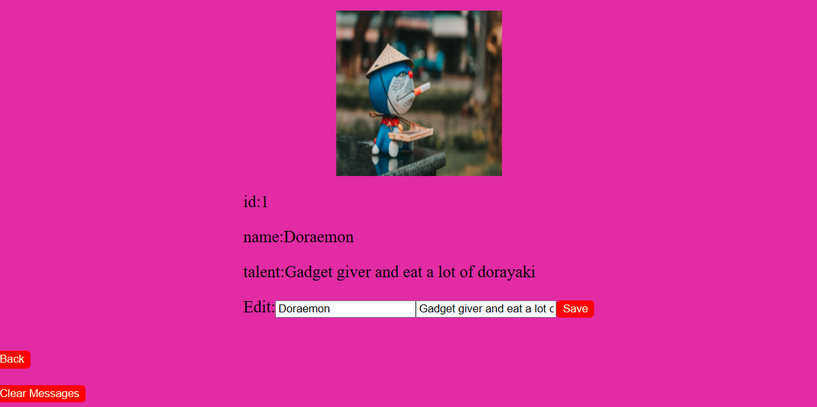
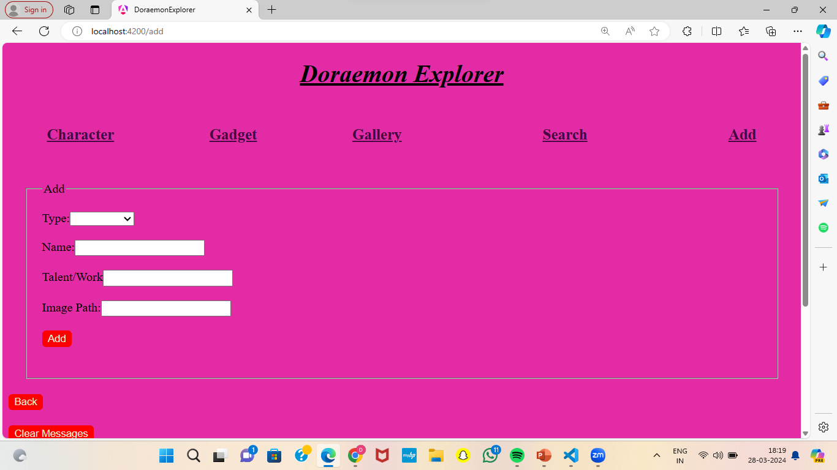
OUTPUT

Slide 8
THANK YOU!

